Slide 1
Navigating the system of higher education: money management for students
The Financial Wellness Center
Notes:
Hi everybody! Welcome. We are going to get started with today’s presentation. I am super excited to be here today to talk to all of you about money management and navigating the system of higher education as a first gen student. So just a little bit about myself, my name is Thaiss Del Rio and I am a first generation student and immigrant from Lima, Peru. I will be a fourth year student at the University of Utah this upcoming fall. And i am double majoring in sociology and political science w a minor in ethnic studies. I know at your age it would have helped me a lot to have someone kinda walk me through the process of applying for funding and even teaching me some basics of money management. Especially as a child of immigrants and an immigrant myself where all of this is brand new information it’s helpful to have someone walk you through it.

Slide 2
01 INTRODUCTION
02 FUNDING YOUR EDUCATION
03
cOLLEGE COSTS
04
LIFE AFTER COLLEGE
Welcome! We’re the Financial Wellness Center.
Let’s talk about ways to pay for college.
Wondering how much college costs? Let’s chat!
What happens after?
Notes:
So this is our agenda for the day! I will briefly introduce who we are and then ashley will go ahead and talk about ways to pay for college. Then ill go ahead and talk about how much college actually costs and lastly ashley will discuss what happens after college. I do want to point out that there is a ton of information that we simply couldn’t fit into this presentation and so we encourage all of you to reach out if you have any questions and we will do the best we can to help answer them.
So let’s go ahead and begin...i want to start off with a very important question and i need all of you to answer this as truthfully as you can,

Slide 3
Which superpower would you like to have?
Notes:
Which superpower would you like to have? (Multiple choice)
a) Mind reading
b) Invisibility
c) Teleportation
d) Flying
e) I already have a superpower

Slide 4
Financial Wellness Center
Help students establish lifelong financial behaviors that will improve the overall well being and quality of life.
Our Mission:
Notes:
All right thanks yall for participating in that….so we are the university of utah’s financial wellness center. in our office, our mission is to READ MISSION. We are determined to help students establish healthy financial habits that will contribute positively to other aspects of our life right like our social, emotional, and physical wellbeing. We like to focus a lot on financial wellness and what that entails for our students. Financial wellness assisting students implement strategies which may help to decrease financial stress, anxiety and stay in school. We are here to help students navigate the financial world through counseling sessions, workshops, webinars, social media posts and more.

Slide 5
Additional resources for first gen students
University of utah
Westminster
Utah valley university
Utah state university
Beacon Scholars: http://diversity.utah.edu/initiatives/initiatives/beacon-scholars/
First Gen Student Resources:
https://westminstercollege.edu/student-life/first-generation-student-resources#0
UVU Multicultural center: https://www.uvu.edu/multicultural/
USU Inclusion center: https://inclusion.usu.edu/
Notes:
As a first generation student and undocumented immigrant, I had no idea where to start or who to ask for help. It may seem confusing and lonely at times, but trust me when I say you are not alone. As many of you are beginning your journey of applying for colleges, I encourage all of you to look into your colleges of choice to see what kind of resources they have to offer for first generation students. We’ve compiled some websites from utah universities that you can access to start looking into how they are supporting their students.

Slide 6
02. Funding your education
Notes:
Ashley section

Slide 7
WAYS TO PAY FOR SCHOOL
FAFSA
SCHOLARSHIPS
LOANS
SAVINGS
Free Application for Federal Student Aid
Scholarships are available through private donors, the University, or individual departments
Federal and Private loans
Some students choose to use savings they have from summer jobs, family, etc.

Slide 8
What is
fafsa?
Notes:
What is the purpose of the FAFSA?
An application to the University of Utah
An application for federal grants and loans
A student loan forgiveness application
I don’t know

Slide 9
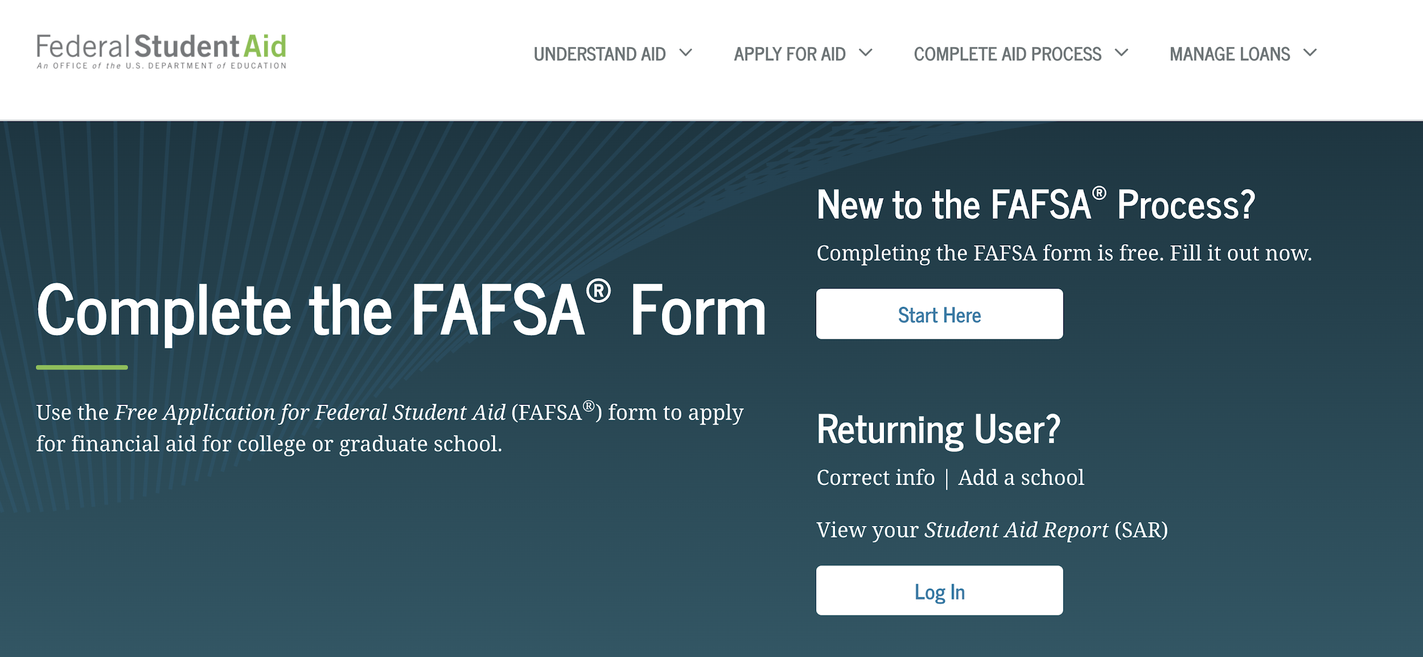
Free
Application
For
Federal
Student
aid
FAFSA

Slide 10
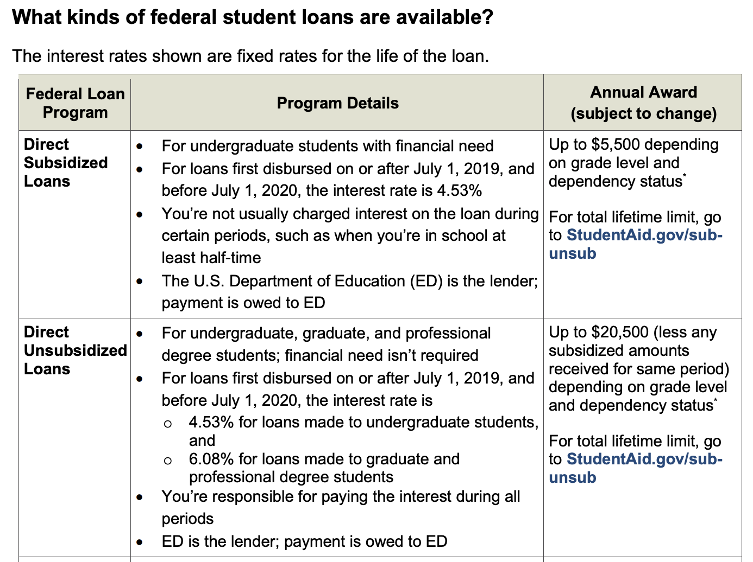
Federal student loans

Slide 11
Funding your education
Private scholarships
University scholarships
Departmental scholarships
Scholarships are offered through private donors
The University offers a wide range of scholarships
Scholarships are available through the department of your major

Slide 12
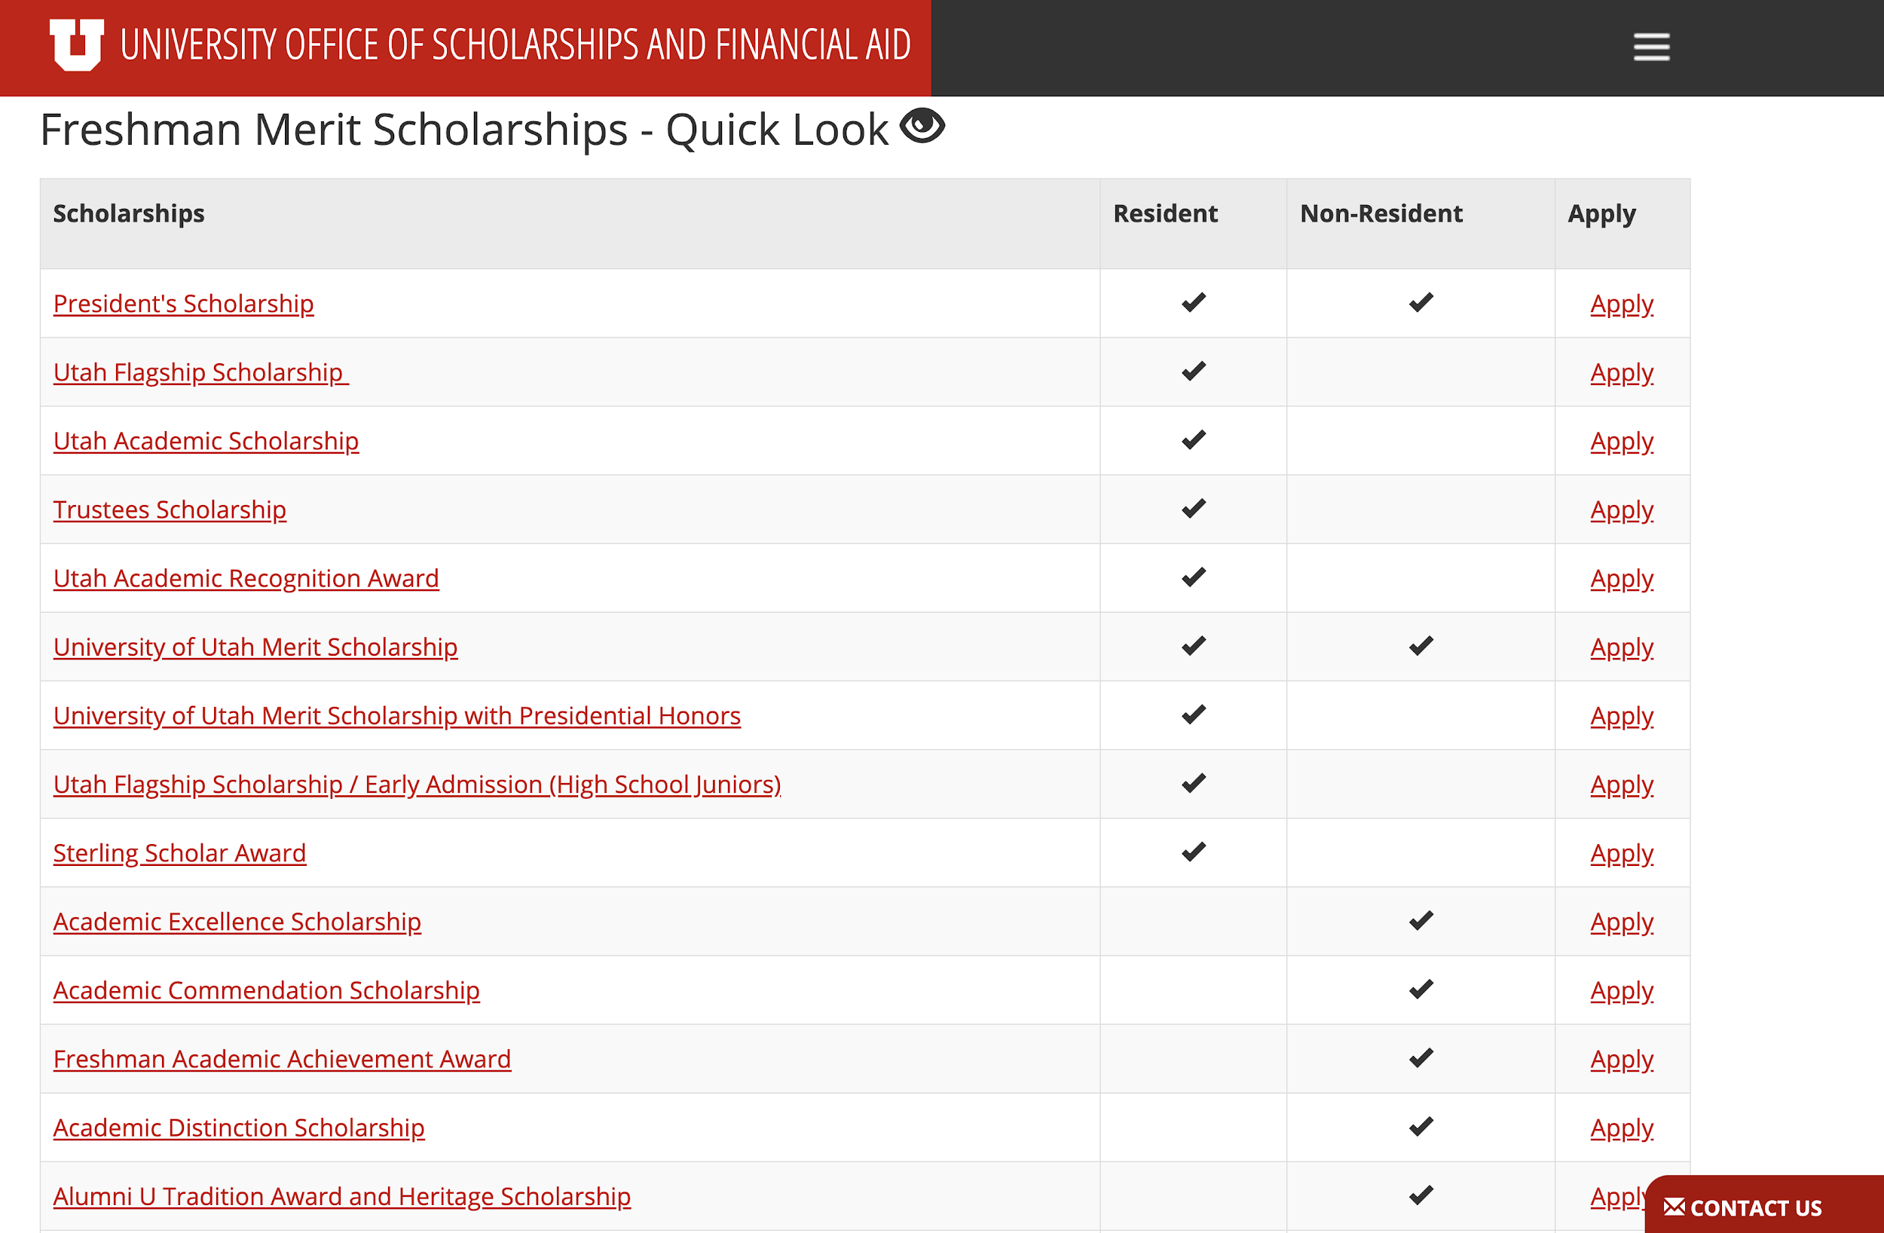
University schoarships

Slide 13
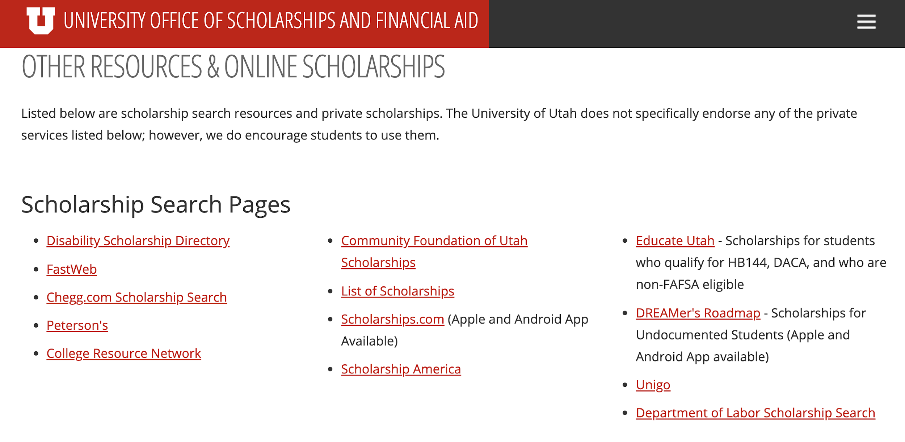
Private scholarships

Slide 14
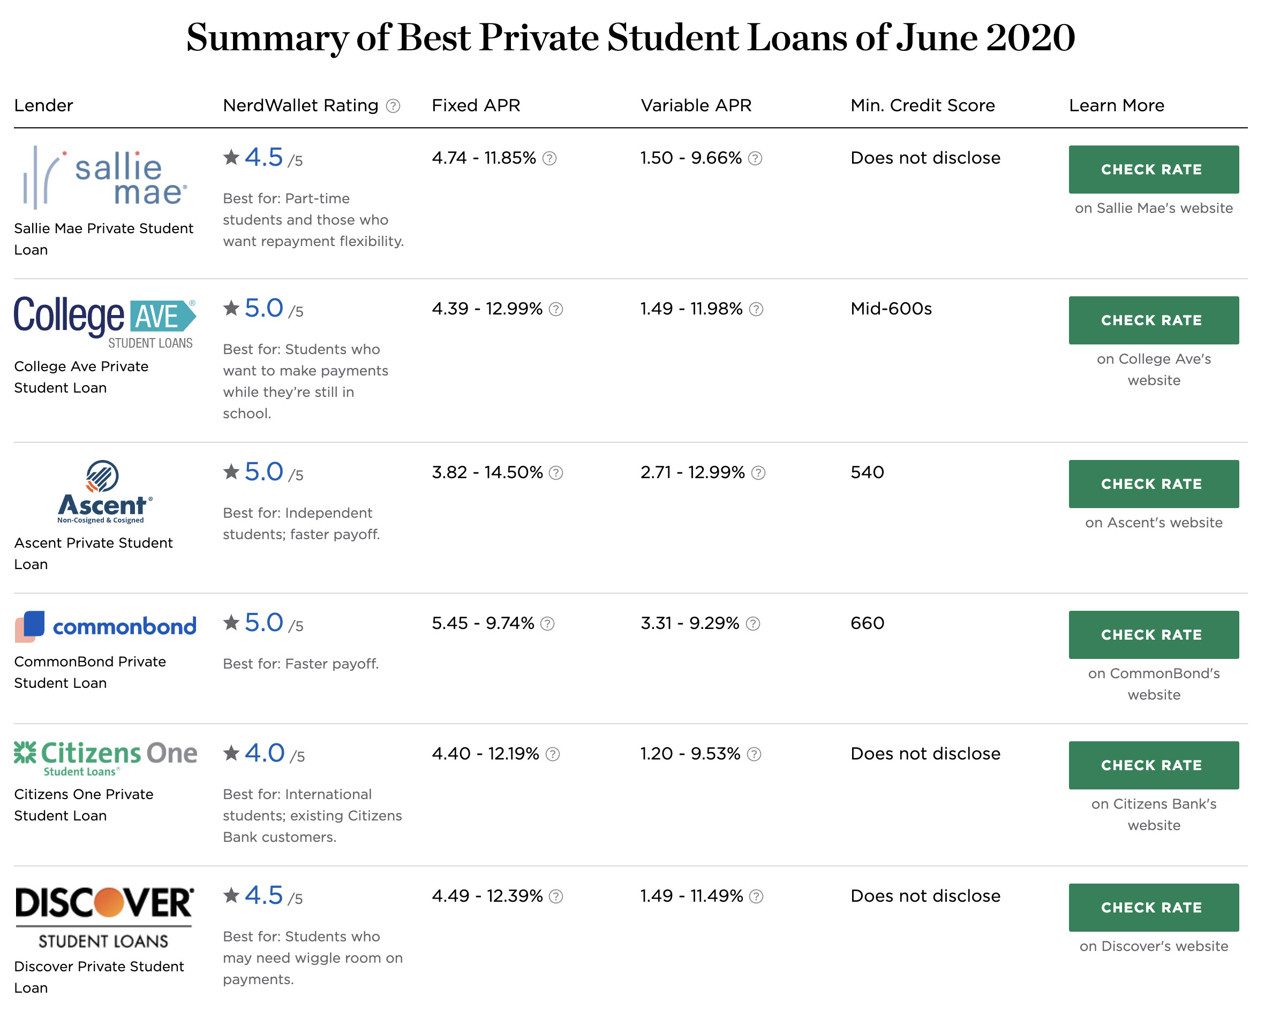
Private student
loans

Slide 15
Working as a student
There are many benefits to working while in school. Building your resume, taking a break from studying, and having some extra spending money are just a few benefits.
Work Study:
Part of the FAFSA - student select “yes” on work study question
Jobs are part time and on campus
Only students who qualify are eligible - increasing your chances of getting hired
Federal government gives money to the employer to pay salary

Slide 16
savings
Savings accounts are a great tool to utilize when saving money for school
Pro tip: open multiple savings accounts with your credit union or bank and give them different names depending on what you are saving for

Slide 17
03. College costs
Notes:
All right so now that ashley has discussed ways that all of you can fund your education, let’s talk about how much college actually costs

Slide 18
How much does
Tuition cost for one semester at the u?
Notes:
How much does tuition cost for one semester at the University of Utah?
$1,965
$3,930
$4,051 - Correct
I don’t know
Yes the correct answer is C! Now please keep in mind that this is only an estimate and is based off a 12 hour credit schedule.

Slide 19
budgeting
Budgeting is the process of creating a plan to spend your money.
STEP 01
STEP 02
Figure out your income.
Visit the website of your college of choice to view tuition, fees, room and board costs.
STEP 03
STEP 04
Figure out what method of budgeting you like best.
Ex: paper and pen, spreadsheets, online apps, etc.,
Review your budget every month and adjust what is needed in order to meet your goals!
Notes:
So when we are discussing college costs, one of the best things you can do when preparing is to create a budget. Creating a budget will keep you organized and give you a better visual of where your money is going and how much you will owe. These are four simple steps that you can take to start creating your budget for school.
First, identify your income. Where is your income coming from? Do you have a part time/full time job? Maybe you have an allowance? WIll you be receiving financial aid or scholarships? WIll that amount be constant for the whole school year? Right so first determine that.
Once you have identified where your money is coming from and how much of it you will have, we advise you to visit the websites of the colleges you are interested in to look over costs of tuition, fees, room and board. Costs will change, as you know, depending on where you plan on going. But most universities have tuition calculators to give you a better idea of how much you’ll be paying. If you cant afford all of it at once, see if they have payment plans or arrangements that you can do. Maybe as a college student you find that you are in need of money for living expenses like food. I know the university of Utah has emergency funds and food pantries that you are able to visit with no cost to you.
Afterwards
Remember, it is going to take time to have a budget that works for you.
Go over your budget every month to see if there is something that you need to change.
LIVING EXPENSES….FEED U PANTRIES...EMERGENCY FUNDS (WOMENS RESOURCE AND ASUU)

Slide 20
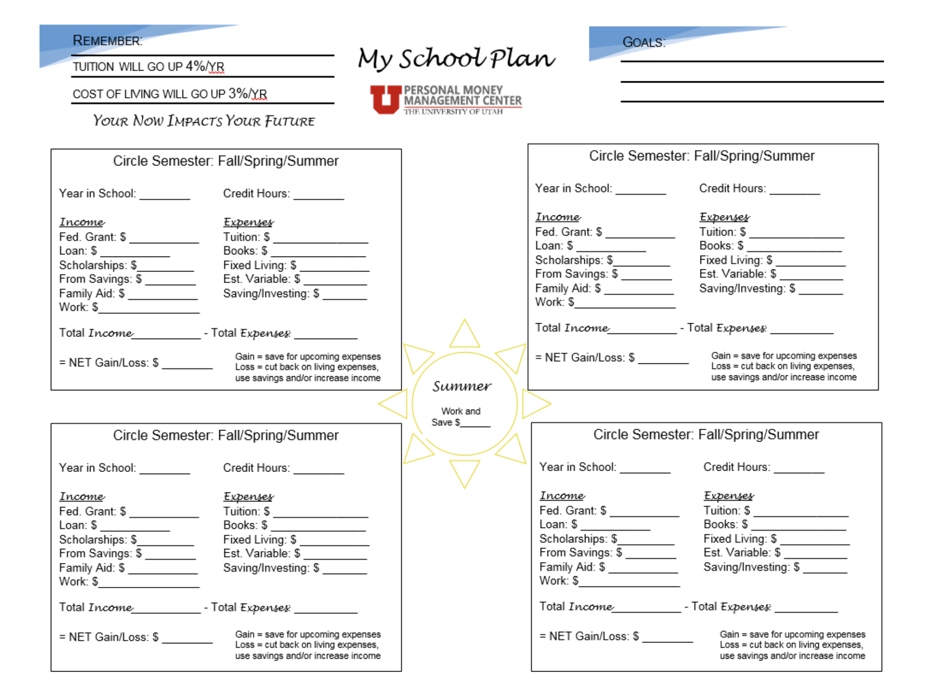
Notes:
creating your college plan

Slide 21
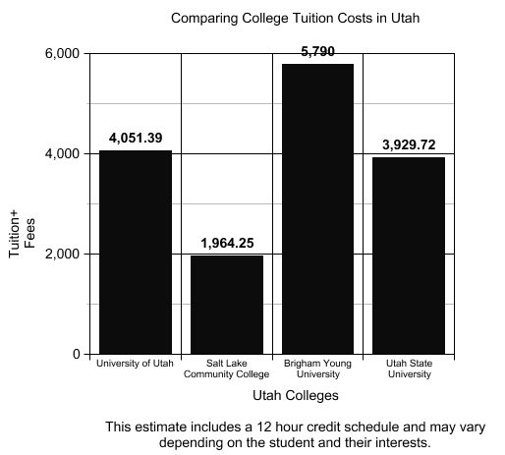
Tuition and fees
Room and board
Tuition
Tuition is due once a semester
Tuition varies depending on your major and the amount of classes you take
This is called “credit hours”
3 credit hours = 1 class
TIP: Visit the websites of the colleges you are interested to compare tuition/fees rates
The cost of your rent will vary depending on if you live on or off campus and if you are required to buy a meal plan
Notes:
Okay so lets go ahead and talk more about tuition and fees because this is really one of the most important factors when considering colleges. READ SLIDE.
As you begin applying for colleges or once you’ve chosen where you want to go...go to the school’s website to get an idea of how much it will
cost to attend. As a first gen. I didnt really understand how costs worked...and it seemed like there was always confusing terms and informatin…
If you are able to live at home you will be saving a lot of money...or even finding someone to room with!

Slide 22
Textbook tips
Buy used or rent from outside retailers
Ask previous students
Before buying anything, make sure you need it!
You will most likely find the cheapest textbooks in a Facebook group. Previous students who are stuck with textbooks they bought are usually willing to sell them for cheap, especially once the semester starts up.
Just because you’re syllabus says you need a textbook doesn’t mean you’ll actually use it!
Textbooks can be costly, save money by buying used or rent them from online sites like Amazon, Chegg, and or Textbooks.com. E-books are also a great option!
Notes:
I wanted to also discuss some other college expenses that you need to keep in mind.
I can not tell you how many times I have bought textbooks before the class began and ended up getting the wrong version. Tips on saving money for texbooks! You can purchase at the bookstore but it is always a little bit more costly to do so..

Slide 23
04. Life after college
Notes:
Ashley section

Slide 24
How are you preparing for your financial future?
Notes:
Applied for scholarships
Opened a bank account
Applied for a credit card
Saving money for school
Nothing yet, but i will start soon

Slide 25
Early life
Working years/ wealth accumulation
retirement
PERSONAL FINANCE LIFE CYCLE
Open a bank account
Start building credit
Learn about personal finance
Pay for education
Utilize employer insurance/retirement benefits
Begin investing in a retirement account
Buy a home
Plan for future generations
Spend money that has been accumulating in retirement accounts

Slide 26
What are retirement accounts?
During your working years, you pay for your expenses with your paycheck. To pay for expenses when you are retired and no longer working, you use the money that you have saved up throughout your career. The money you and your employer put in your retirement account earn interest over time and grow.
You and often times your employer will contribute to a retirement account. These accounts are typically a 401(k), IRA, and/or 403(b) accounts. Within your account, you choose what you invest in.

Slide 27
Case study
Rebecca earned her Bachelor’s degree from the University of Utah. To pay for her Bachelor’s degree, she received $6,000 each semester from a Pell grant. She also received $3,000 in scholarships each semester to help cover her living expenses. Rebecca also participated in work study while in school. Because of her pell grant, scholarships, and work-study Rebecca was able to graduate debt free!
She earns $45,000 per year. Now that Rebecca is working, she is able to start saving money each month and build an emergency fund. Rebecca would like to buy her first home, so she has also opened a savings account for a down payment on a home. Rebecca saves 15% of her paycheck each month into her 401(k) retirement account offered through her employer.

Slide 28
Personal finance for first gen students
Utilize campus resources!
Social media
Consumer financial protection bureau (CFPB)
Workshops & Webinars
Financial Counseling
Monthly newsletters
Follow us on social media!
Instagram: @uofu_financialwellness
Twitter: @uofu_money
There are many other influencers who share real tips about money on social media
Dave Ramsey
The Money Guy Show
Clark Howard
Janae Talks Money
The Budget Mom
Fun Cheap or Free
The CFPB is a great place to learn about the basics of personal finance

Slide 29
Financial Wellness Center
Olpin Student Union Building
200 S. Central Campus Dr., Room 317
Salt Lake City, UT 84112
Office phone: (801) 585-7379
Financial Wellness Center
Budgeting
Managing student loans/scholarships
Investing
Credit
Insurance
So much more!
Counseling Events Resources Blog
Notes:
Come see us!

Slide 30
THANKS
Please keep this slide for attribution.

