Slide 1
Get Rich… Slowly
Lasting Principles of Personal Financial Management
PATHS Program
June 22, 2020

Slide 2
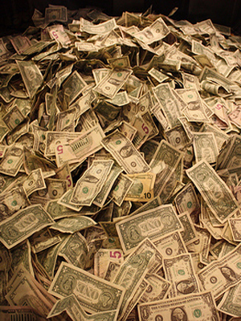
Let’s Get Started!

Slide 3
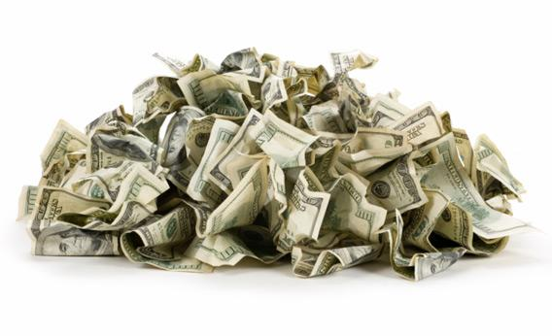
What Is Wealth?
Wealth = (What you own)
minus (What you owe)
“Assets”
“Liabilities”

Slide 4
What’s a Millionaire?
Household with a net worth (or wealth) of:
$1,000,000 (or more)
Let’s play a game...

Slide 5
The Millionaire Game
Rules:
Statements appear on screen.
Each person decides
True or False.
Indicate which answer you choose by selecting T or F from the poll.

Slide 6
Millionaire Statements
Statement 1:
Most millionaires are college graduates.
Statement 2:
Most millionaires work fewer than 40 hours per week.
Statement 3:
The average total household annual income of today’s millionaires is about $120,000.

Slide 7
Millionaire Statements
Statement 4:
Millionaires tend to avoid the stock market.
Statement 5:
At age 18, you decide not to purchase soft drinks from the vending machine and save $1.50 a day.
You invest this $1.50 a day at 8% annual interest until you are 67.
At age 67, your savings are almost $150,000.

Slide 8
How Did We Do?
For each statement, hold up the card
T for true
F for false
According to answer sheet:
correct answer = + 5
incorrect answer = - 5
Each team has 1 Millionaire card
correct (+10); incorrect (-10)
PATHS Students
Millionaire Champion
June 2020
Sources: Millionaire Next Door, Millionaire Mind,
& Getting Rich in America

Slide 9
Statement 1
Most millionaires are college graduates.
80% of millionaires are college graduates.
18% have Master’s degrees
8% have law degrees
6% medical degrees
6% Ph.D.s
True
Diploma
Education

Slide 10
Statement 2
Most millionaires work fewer than 40 hours per week.
About 67% of millionaires work 45 to 55 hours a week.
False
Earn

Slide 11
Statement 3
The average total household income of today’s millionaires is about $120,000.
Total income reported among millionaire households averaged $119,000 (2005).
Frugal, Frugal, Frugal
True
Save

Slide 12
Statement 4
Millionaires tend to avoid the stock market.
Long term, the S&P 500 Stock Index has increased about 10% compound annual rate of return, exceeding the return on any other investment.
False
Invest

Slide 13
Statement 5
At age 18, you decide not to purchase vending machine soft drinks & save $1.50 a day.
You invest this $1.50 a day at 8% annual interest until you are 67.
At age 67, your savings are almost $150,000.
Because of the power of compound interest, small savings can make a difference,
about $300,000 in this case.
False
Save & Invest

Slide 14
The Moral of the Story?
A formula for financial fitness:
E² + S + I² = F²
Education, Earn, Save, Invest and Insure
equals Financial Fitness

Slide 15
How Many Millionaires?*
How many U.S. households?
approximately 127M
Of those, how many are millionaire households?
net worth ≥ 1M, excluding primary residence
≅ 18M households (about 14%)
a new high reached in 2014
^{*estimates by Investopedia}

Slide 16
People who “have it all,” didn’t get there by accident. They had a plan and followed it.
Little Happens without a Plan!
Where Are You Now?
Where Do You Want to Be?
Then …
E² + S + I² = F²

Slide 17
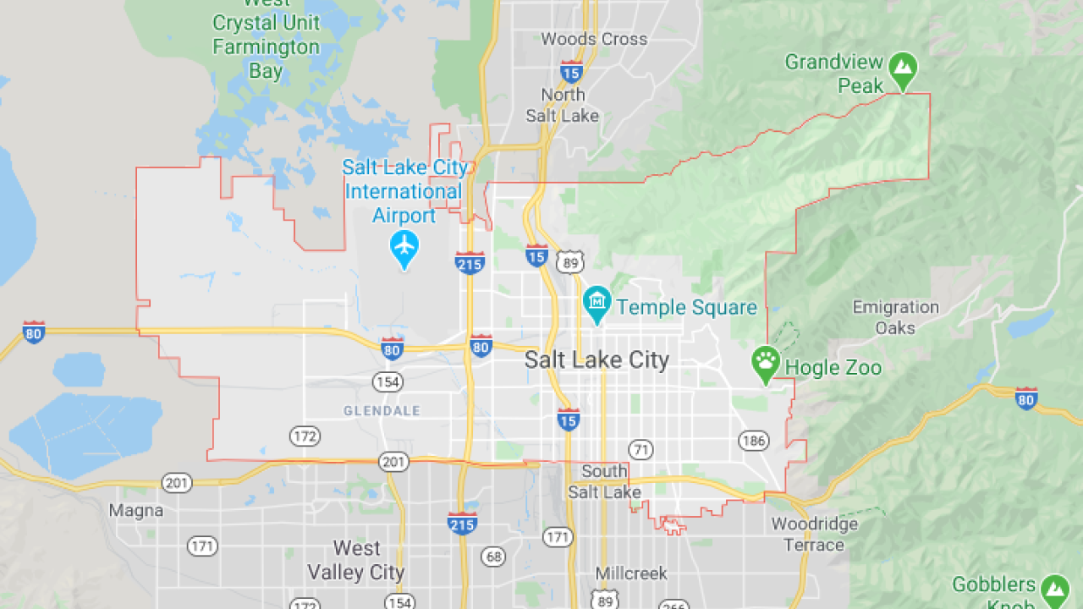
You are here
Before setting out on a journey …
… it helps to know your starting point

Slide 18
Where Are You Now?
Two common measures of financial status:
Net Worth Statement
(net wealth statement)
Income & Expense Statement
(cash flow statement)

Slide 19
Net Worth Statement (as of: June 22, 2020)
Assets
Liquid Assets
Check/savings accounts
Securities
Stock, bonds, mutual funds
Real estate
House value
Long-term Assets
Individual Retirement Acct.
Personal property
Automobile
Furniture, Jewelry
_________
Total Assets: $100,000
Liabilities
Unpaid bills
Utilities, medical bills
Insurance premiums
Loans
Credit card balance
Automobile loan balance
Mortgage loan balance________
Total Liabilities: $40,000
________
Net Worth $60,000
(or one’s “wealth”)
Balance Sheet
Total Liab + Net Worth $100,000

Slide 20
Where Are You Now?
Two common measures of financial status:
Net Worth Statement
(net wealth statement)
Income & Expense Statement
(cash flow statement)

Slide 21
Income Statement (June 2020)
Income
Gross salary
Investment income (e.g., interest received)
Total Income (for month of June) _______
Expenditures (fixed and discretionary)
Housing payment, repairs bill paid
Utilities paid
Auto (loan payments, insurance payment, gas, etc.)
Medical bill paid
Food and Clothing bill paid
Taxes paid
Recreation expenses
Total Expenditures _______
Cash surplus or deficit (income - expenditures) __________

Slide 22
Central Tendency Measures of U.S. Household Income
Average (or mean):
~ $66,000
Median (the middle household):
~ $51,000
Why the difference?
very high income households bring mean up
median removes this impact

Slide 23
Goals: A Critical Set of First Choices
Think about and list some of your goals
financial and non-financial
What you want:
to be
to have
to do
Time frame:
Short term
Intermediate term
Long term
Estimate the cost of achieving these goals
With end in mind,
develop a roadmap (plan) on how to get there

Slide 24
E²: Education & Earn
Who remembers the formula for Financial Fitness?
E² + S + I² = F²
To achieve your financial goals:
Spend less than you receive.
Two ways:
Spend less
Receive more

Slide 25
Productivity: Education & Earnings (Median by group)
High school dropout
$25,376
High school graduate
$34,736
Some college
$38,532
College graduate
$57,252
Master’s degree
$68,952
Professional degree
$85,228
Source:
U.S. Bureau of Labor Statistics

Slide 26
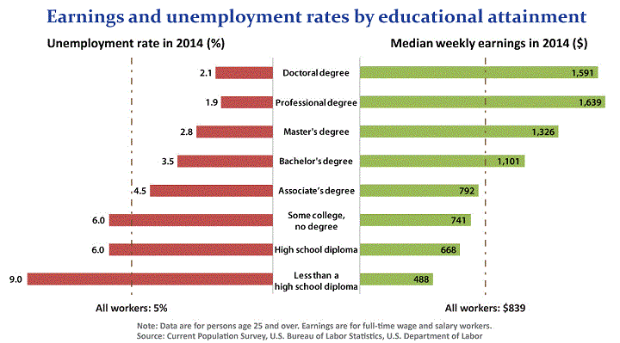
Education Pays!
Effect of Education on Employment and Earnings
Weekly earnings x 52 = annual earnings

Slide 27
S: Economics of Saving
E² + S + I² = F²
To Save:
spend less than you receive
Two ways:
Receive more
Spend less

Slide 28
What Is Saving?
We do 3 things with our income:
Pay taxes
Spend
Save
Economists define “saving” as:
Saving = [Income – taxes] – spending
Thus,
Saving = after tax income that is NOT spent
⇒ Purchase goods & services from gov’t
⇒ Purchase goods & services today
⇒ Purchase goods & services in future

Slide 29
Why Do People Save?
To provide for future wants
Intermediate & long-term goals
This is the BENEFIT of saving
“Don’t sacrifice what you want most, for what you think you want right now”

Slide 30
Choosing Fruit vs. Chocolate
Choosing Today
Eating Next Week
Time
If you were
deciding today,
would you choose
fruit or chocolate
for next week?

Slide 31
Patient Choices for the Future
Choosing Today
Eating Next Week
Time
Today, subjects
typically choose
fruit for next week.
74%
choose
fruit

Slide 32
Instant Gratification
Choosing and Eating
Simultaneously
Time
If you were
deciding today,
would you choose
fruit or chocolate
for today?

Slide 33
Time Inconsistent Preferences
Choosing and Eating
Simultaneously
Time
Today, subjects
typically choose
chocolate for today.
70%
choose
chocolate

Slide 34
Retirement Savings Assessment
10% save too much
30% save about right amount
60% save too little
David Laibson
Harvard University
Right amount?
10 – 15% of gross income
Varies by circumstances
Consistency is key

Slide 35
So what does Saving Require . . . ?
…that people control their spending
control emotions
For example: use Nudges referred to as “commitment devices”
Opt-out instead of opt-in
“Save More Tomorrow” - The SMarT plan
Step-down principle

Slide 36
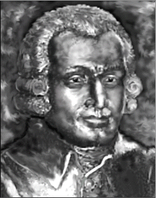
Theory of Moral Sentiments (Adam Smith, 1759)
“The pleasure which we are to enjoy ten years hence, interests us so little in comparison with that which we are to enjoy today…
[However,] the spectator [cognitive self] does not feel the solicitations of our present appetites.
To him the pleasure which we are to enjoy a week hence, or a year hence, is just as interesting as that which we are to enjoy this moment.”

Slide 37
Saving Requires . . .
…that people control their spending
control emotions with commitment devices
create and use a budget
(income/cash flow statement)

Slide 38
Saving Requires . . .
…that people control their spending
control emotions with commitment devices
create and use a budget
(income/cash flow statement)
3. understand credit

Slide 39
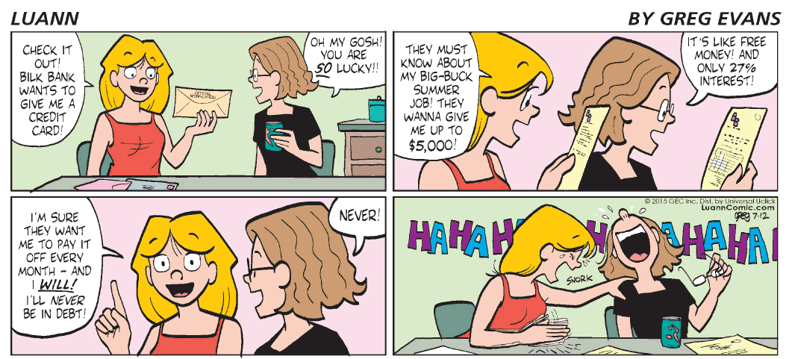
Credit & Credit Cards
Convenience users
Pay full balance each month
Borrowers
Carry balance and pay finance charges

Slide 40
Consumer Protection
Truth and Lending Act (1969) requires creditors:
to disclose the annual percentage rate (APR)
% rate of interest you pay in a single year on the money you have borrowed
yields a true rate of interest
allows comparison
with other credit sources
“apples with apples”

Slide 41
Credit Card Borrowing: a Cost-Benefit Decision
B(X)
C(X)
BENEFIT
=
Convenience
(e.g., hotel reservations,
concert tickets, etc.)
COST
=
Debt, at very high APR

Slide 42
Some Credit Card Facts
Americans hold more than 1.5 billion credit cards –
4.5 cards per capita.
about 50% of credit cards are Visa and Mastercard
2016:
average U.S. household credit card debt:
$7,281
average U.S. indebted households credit card debt:
$16,061
average APR on credit cards: 14.95%
two-thirds of credit card offers sent in mail have teaser rate

Slide 43
College Students & Credit Cards
67% of college freshman have credit cards
90% of all college seniors have ≥ 1 credit card
College student survey:
40% charged knowing didn’t have money to pay bill
60% surprised at how high their balance had reached

Slide 44
Students: Be Mindful!
only 17% of college students pay off all credit card debt each month
71% of cardholders age 25 – 34 carry a balance on credit card(s)

Slide 45
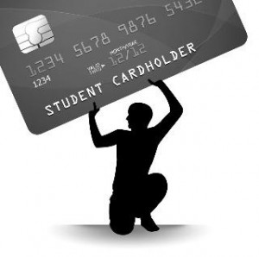
Stop & Think!
Suppose you have balance of $3,900 on your card
APR = 18%
You pay only the minimum amount each month
→ will take 35 years to pay off your bill
End up paying $10,096 in interest + $3,900 principal
Recommendation:
Be a convenience user; do NOT ever carry a balance!

Slide 46
I: Time to Invest Your Money
E² + S + I² = F²
Suppose you receive a high-school graduation gift from your uncle
$10,000
In 10 years you plan to purchase your first home and you need a down-payment
Where would you invest this money?

Slide 47
Investment Choices
Concepts that arise in this discussion?
Passbook (savings) account
U.S. Government Bonds
Stock
Return
Liquidity
Risk

Slide 48
Key Principle of Personal Finance
Your Best Protection is Knowledge!
Understand:
the power of compound interest

Slide 49
Car Buying
Suppose you graduated from college & landed your 1st career job
One of your first purchases might be a car.
In 2016, you are considering (with your Uncle’s graduation gift):
Audi TT: $50,000
Used Toyota Camry: $20,000
If you saved the difference at 9% CAGR until retirement in 40 years, how much would you have at retirement?
P₄₀ = $30,000(1+0.09)⁴⁰
= $942,000
How to become a millionaire – save $30K when you’re young!
Save $30,000

Slide 50
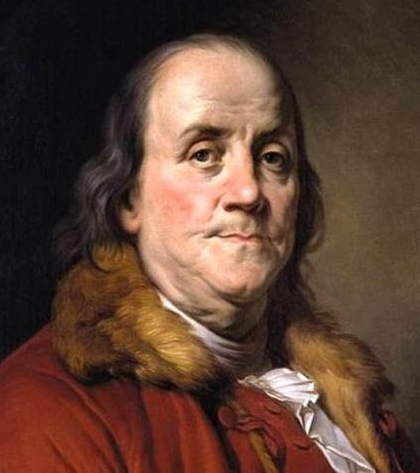
The Power of Compound Interest
Upon his death in 1791, Benjamin Franklin left $5,000 to each of his favorite cities – Boston and Philadelphia.
He stipulated that the money should be invested and not paid out for 100 - 200 years.
at 100 years, each city could withdraw $500,000.
after 200 years, they could withdraw the remainder.

Slide 51
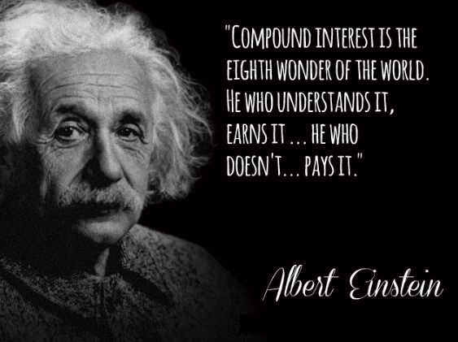
Power of Compounding
Actual result:
In 1891: Each city withdrew $500,000 &
invested the remainder.
In 1991: Each city withdrew approximately:
$20,000,000.
Compound interest is
the eighth wonder of
the world.
He who understands it, earns it …
he who doesn’t … pays it.

Slide 52
Investment Choices
Concepts that arise in this discussion?
Passbook (savings) account
U.S. Government Bonds
Stock
Return
Liquidity
Risk

Slide 53
Risk
. . . comes from many sources, but
we’ll only address one source of risk.

Slide 54
Market Volatility

Slide 55
Consider this Portfolio: Smooth and Steady: 1926–2014
1
1926
1936
1946
1956
1966
1976
1986
1996
2006
Notes:
Ibbotson® SBBI® 1926–2011
An 86-year examination of past capital market returns provides historical insight into the performance characteristics of various asset classes. This graph illustrates the hypothetical growth of inflation and a $1 investment in four traditional asset classes over the time period January 1, 1926, through December 31, 2011.
Large and small stocks have provided the highest returns and largest increase in wealth over the past 86 years. As illustrated in the image, fixed-income investments provided only a fraction of the growth provided by stocks. However, the higher returns achieved by stocks are associated with much greater risk, which can be identified by the volatility or fluctuation of the graph lines.
Government bonds and Treasury bills are guaranteed by the full faith and credit of the U.S. government as to the timely payment of principal and interest, while stocks are not guaranteed and have been more volatile than the other asset classes. Furthermore, small stocks are more volatile than large stocks, are subject to significant price fluctuations and business risks, and are thinly traded.
About the data
Small stocks in this example are represented by the fifth capitalization quintile of stocks on the NYSE for 1926–1981 and the performance of the Dimensional Fund Advisors, Inc. (DFA) U.S. Micro Cap Portfolio thereafter. Large stocks are represented by the Standard & Poor’s 90 index from 1926 through February 1957 and the S&P 500® index thereafter, which is an unmanaged group of securities and considered to be representative of the U.S. stock market in general. Government bonds are represented by the 20-year U.S. government bond, Treasury bills by the 30-day U.S. Treasury bill, and inflation by the Consumer Price Index. Underlying data is from the Stocks, Bonds, Bills, and Inflation® (SBBI®) Yearbook, by Roger G. Ibbotson and Rex Sinquefield, updated annually. An investment cannot be made directly in an index.

Slide 56
Or How About This Portfolio: A Bumpy Ride: 1926–2014
1
1926
1936
1946
1956
1966
1976
1986
1996
2006
Notes:
Ibbotson® SBBI® 1926–2011
An 86-year examination of past capital market returns provides historical insight into the performance characteristics of various asset classes. This graph illustrates the hypothetical growth of inflation and a $1 investment in four traditional asset classes over the time period January 1, 1926, through December 31, 2011.
Large and small stocks have provided the highest returns and largest increase in wealth over the past 86 years. As illustrated in the image, fixed-income investments provided only a fraction of the growth provided by stocks. However, the higher returns achieved by stocks are associated with much greater risk, which can be identified by the volatility or fluctuation of the graph lines.
Government bonds and Treasury bills are guaranteed by the full faith and credit of the U.S. government as to the timely payment of principal and interest, while stocks are not guaranteed and have been more volatile than the other asset classes. Furthermore, small stocks are more volatile than large stocks, are subject to significant price fluctuations and business risks, and are thinly traded.
About the data
Small stocks in this example are represented by the fifth capitalization quintile of stocks on the NYSE for 1926–1981 and the performance of the Dimensional Fund Advisors, Inc. (DFA) U.S. Micro Cap Portfolio thereafter. Large stocks are represented by the Standard & Poor’s 90 index from 1926 through February 1957 and the S&P 500® index thereafter, which is an unmanaged group of securities and considered to be representative of the U.S. stock market in general. Government bonds are represented by the 20-year U.S. government bond, Treasury bills by the 30-day U.S. Treasury bill, and inflation by the Consumer Price Index. Underlying data is from the Stocks, Bonds, Bills, and Inflation® (SBBI®) Yearbook, by Roger G. Ibbotson and Rex Sinquefield, updated annually. An investment cannot be made directly in an index.

Slide 57
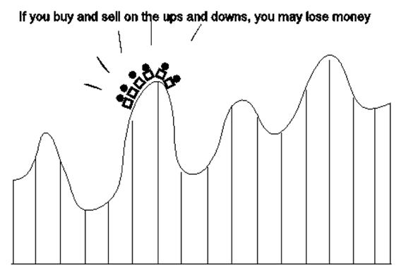
Why Would Anyone Take This Risk?
In high school saving for college
Now in college and need the money

Slide 58
Would You Ride a Bull?
for $5?
for $50?
for $500?
for $5,000?
for $50,000?
Likely to get more risk takers as the reward rises!

Slide 59
Greater Return . . .
accept the risk of:
Riding the Bull
Riding the
Roller Coaster
… or

Slide 60
Stocks and T-Bills: 1926–2014
$100k
Compound annual return
$4,677
10k
• Large Co. stocks
10.1%
1k
• U.S. Treasury bills
3.5%
100
$21
10
1
0.10
1926
1936
1946
1956
1966
1976
1986
1996
2006
Ibbotson® SBBI® Past performance is no guarantee of future results. Hypothetical value of $1 invested at the beginning of 1926. Assumes reinvestment of income and no transaction costs or taxes. This is for illustrative purposes only and not indicative of any investment. An investment cannot be made directly in an index. © 2014 Morningstar. All Rights Reserved.
Notes:
Ibbotson® SBBI® 1926–2013
An 88-year examination of past capital market returns provides historical insight into the performance characteristics of various asset classes. This graph illustrates the hypothetical growth of inflation and a $1 investment in four traditional asset classes over the time period January 1, 1926, through December 31, 2013.
Large and small stocks have provided the highest returns and largest increase in wealth over the past 88 years. As illustrated in the image, fixed-income investments provided only a fraction of the growth provided by stocks. However, the higher returns achieved by stocks are associated with much greater risk, which can be identified by the volatility or fluctuation of the graph lines.
Government bonds and Treasury bills are guaranteed by the full faith and credit of the U.S. government as to the timely payment of principal and interest, while stocks are not guaranteed and have been more volatile than the other asset classes. Furthermore, small stocks are more volatile than large stocks, are subject to significant price fluctuations and business risks, and are thinly traded.
About the data
Small stocks in this example are represented by the Ibbotson® Small Company Stock Index. Large stocks are represented by the Standard & Poor’s 90 Index from 1926 through February 1957 and the S&P 500® Index thereafter, which is an unmanaged group of securities and considered to be representative of the U.S. stock market in general. Government bonds are represented by the 20-year U.S. government bond, Treasury bills by the 30-day U.S. Treasury bill, and inflation by the Consumer Price Index. Underlying data is from the Stocks, Bonds, Bills, and Inflation® (SBBI®) Yearbook, by Roger G. Ibbotson and Rex Sinquefield, updated annually. An investment cannot be made directly in an index.

Slide 61
Two Prudent Strategies for Dealing with Volatility Risk

Slide 62
Prudent Strategies to Deal with Risk
1. Invest for the Long-Term
. . . if you think long-term, the ups exceed the downs.

Slide 63
The Bulls and the Bears
(1926 – 2016)
Think long term!

Slide 64
Prudent Strategies to Deal with Risk
Don’t Put All Your Eggs in One Basket
All money in one stock?
Could spill all the eggs

Slide 65
Prudent Strategies to Deal with Risk
2. Diversify
Don’t Put All Your Eggs in One Basket
Diversify across asset class
Stocks and bonds
Diversify within asset class
Stock from different industries

Slide 66
Avoid the All-Eggs-in-One-Basket Temptation
Had you invested $10,000 in AAPL in 2003,
by 2020 your investment would have grown to
___________?
CAGR?
43%
Not so great if things go south
$760,000

Slide 67
To Summarize

Slide 68
Three Key Variables in Compound Interest
How much one saves out of income
10 – 15% of gross income

Slide 69
Three Key Variables: the rate of return
Rate of return
Compound interest is powerful
e.g., consider 2 cases: one-time investment of $10,000 for 40 years
A invested at 8%
B invested at 5%

Slide 70
Power of Compounding: Importance of i
2020 - 2060
$300,000
$250,000
$217,245
$200,000
$150,000
$100,000
$70,400
$50,000
$10,000
$10,000
$0
Investment A
40
$10,000
5%
Investment B
40
$10,000
8%
Years invested:
Amount Contributed:
Rate of return:

Slide 71
Two Key Variables: How many years invested
Interest rate, i
Length of investment
Start early to benefit from compounding
Consider investors A & B
Both invest in S&P 500:
A invests $2,000 per year from 1990 - 1999, then watches grow.
B invests $4,000 per year from 2000 - 2009.
Note: these are “annuities”

Slide 72
Power of Compounding: Importance of n
Investor A
Investor B
$140k
120
Investor A
Investor B
100
2000 – 2009
1990 – 2009
80
60
$60,759
$40,000
40
Invested in S&P 500
$42,118
$20,000
Invested in S&P 500
20
0
Annual contribution:
$2,000
Annual amount contributed:
$4,000
Years contributing:
10
Years contributing:
10
Notes:
Power of Compounding
It’s easy to procrastinate when it comes to initiating a long-term investment plan. However, the sooner you begin, the more likely it is that the plan will succeed.
This image illustrates the effects of compounding over time. Investor A began investing in stocks at the beginning of 1987, investing $2,000 each year for 10 years. After 10 years, Investor A stopped contributing to the portfolio but allowed it to grow for the next 10 years. The $20,000 outlay grew to $113,233 by year-end 2006.
Investor B postponed investing for 10 years. At the beginning of 1997, Investor B began investing $4,000 each year in stocks for 10 years. The $40,000 outlay of Investor B grew to $57,245 by year-end 2006.
By starting early, and thereby taking advantage of compounding, Investor A accumulated $55,988 more than Investor B, while still investing $20,000 less.
Returns and principal invested in stocks are not guaranteed. The data assumes reinvestment of income and does not account for taxes or transaction costs.
About the data
Stocks are represented by the Standard & Poor’s 500®, which is an unmanaged group of securities and considered to be representative of the stock market in general. An investment cannot be made directly in an index.

Slide 73
Two Key Messages from Compound Interest Story
Save and Invest . . .
Early
Consider . . .
Stocks

Slide 74
Concluding Advice
Take a long-term perspective
Reinvest interest, dividends
Do not remove principal
Don’t chase the hot fund!
Be patient – “Get Rich Slowly”
Recognize the importance of:
Starting early, and
Minding the gap – pay attention to rates of return
some stocks (via mutual/index funds) in portfolio
Diversify
Through mutual funds

Slide 75
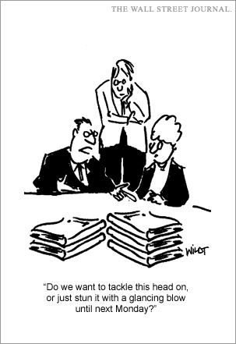
Just Do It!
Knowledge is great … but
Getting Started is the most difficult step in your personal financial life!
Humans want to procrastinate
Take the first step
next steps are easier.

Slide 76
Questions…

